Slide 1
한국 IT 교육원
졸업작품 예상 기술 구조도
강정임

Slide 2

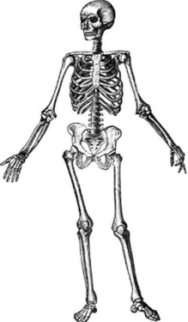
OpenApi
Jquery Plugins, Css Framework(Bootstrap)
Rest(url)
Javascript
Internet
Bigdata
Server
DBMS
(MySQL)
Css
Http Request
Media Query
Python
Http Response
Rest(url)
Html
Spring Framework
→ Jsp
→ Java
Web Browser
Web Browser
Client Side Technologies
Server Side Technologies

